Slide 1
Endocrine Control Systems

Slide 2
Why should a dentist (or a doctoral student) care about endocrinology
Clinical manifestations of endocrine pathophysiology
Diabetes (Insulin Insufficiency/Resistance)
Periodontitis
Mucusal disease
Altered taste
Parotid gland enlargent
Potential hypo/hyperglycemia
Hypoparathyroidism (Not Enough PTH)
Low calcium density, hypoplasia of enamel and dentin
Candidiasis
Delayed eruption, shortened roots
Hyperthyroidism (T3/T4 Overproduction)
Malocclusion
Demineralization
Anxiety/restlessness
Acromegaly (GH Overproduction)
Accelerated tooth eruption
Enlarged jaw, abberant tooth spacing
Cushing’s (Cortisol Overproduction)
Periodontis, swelling of gums
Easy bruising
Addison’s Disease (Cortisol Insufficiency)
Blotchy melanin patches in oral mucosa

Slide 3
Things you (should) already know
Regulation of renal function (Tigyi)
Renin/Angiotensin/Aldosterone/ANF/Vasopressin
Regulation of GI function (Johnson)
Gastrin/CCK/GIP/Secretin/VIP/Motilin
Blood Pressure Regulation (O’Connell)
Angiotensin/Vasporessin/Adrenaline/Noradrenaline/Dopamine/Endothelin
Cardiac Function (Mancarella)
ANP/Adrenaline/Noradrenaline/Acetylcholine
Synaptic Transmission (Adebiyi)
Serotonin/Acetylcholine/GABA/Histamine/Aspartate/Glutamate/NO

Slide 4
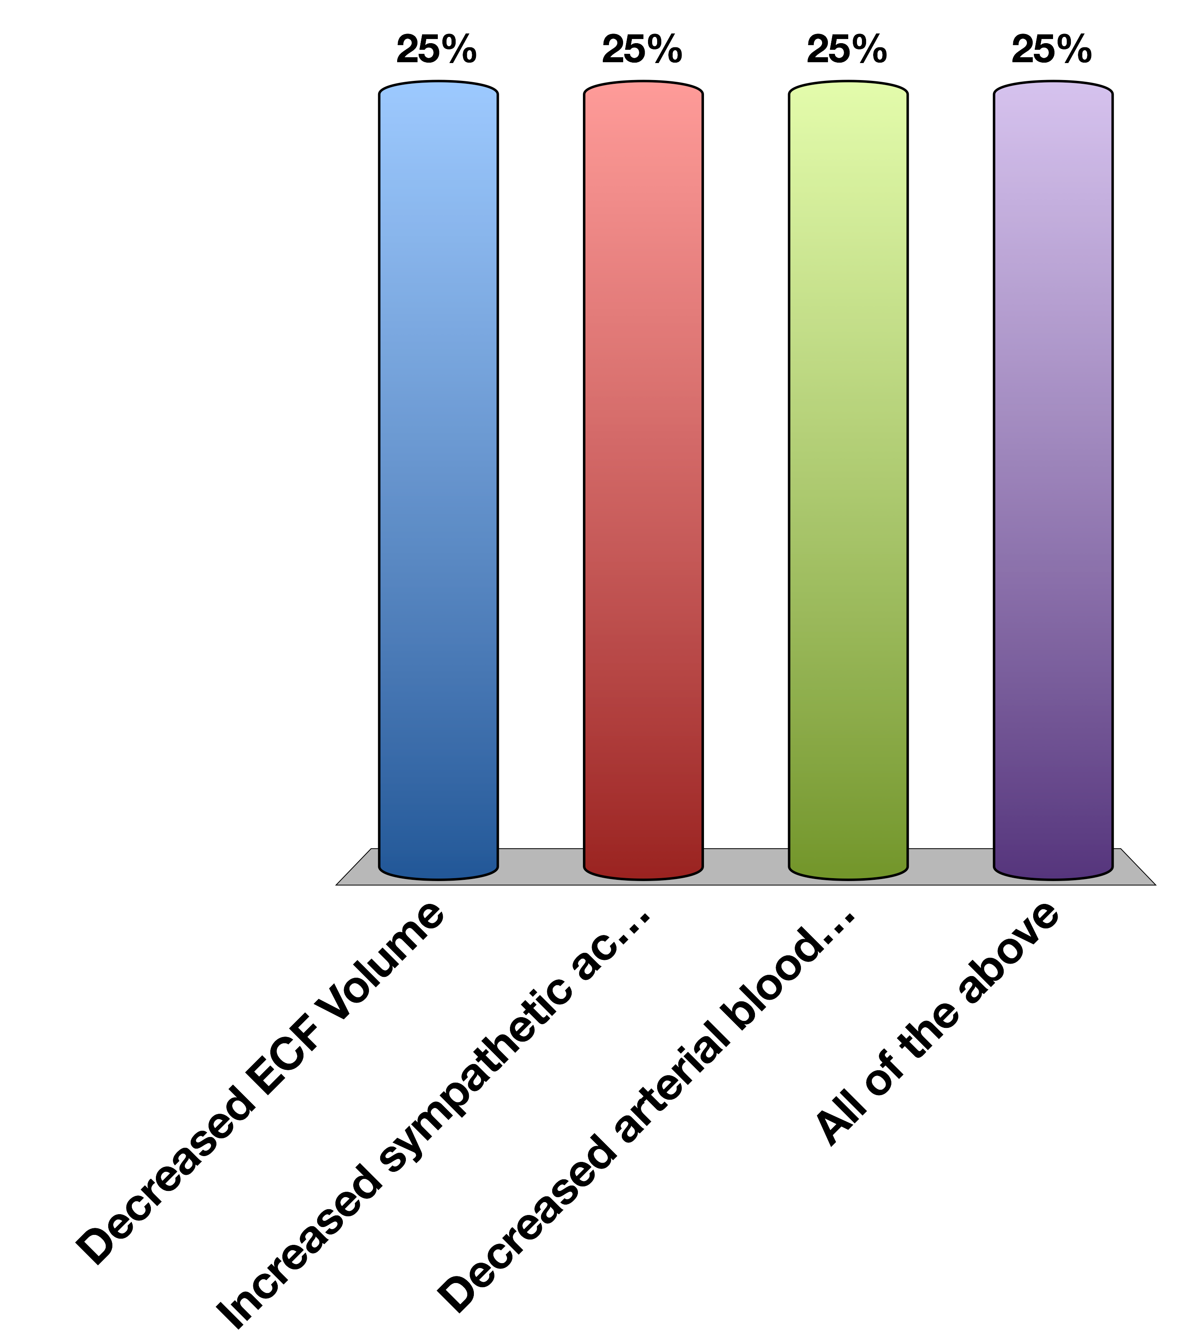
What is sensed by the JG Cells?
Decreased ECF Volume
Increased sympathetic activity
Decreased arterial blood flow
All of the above
15

Slide 5
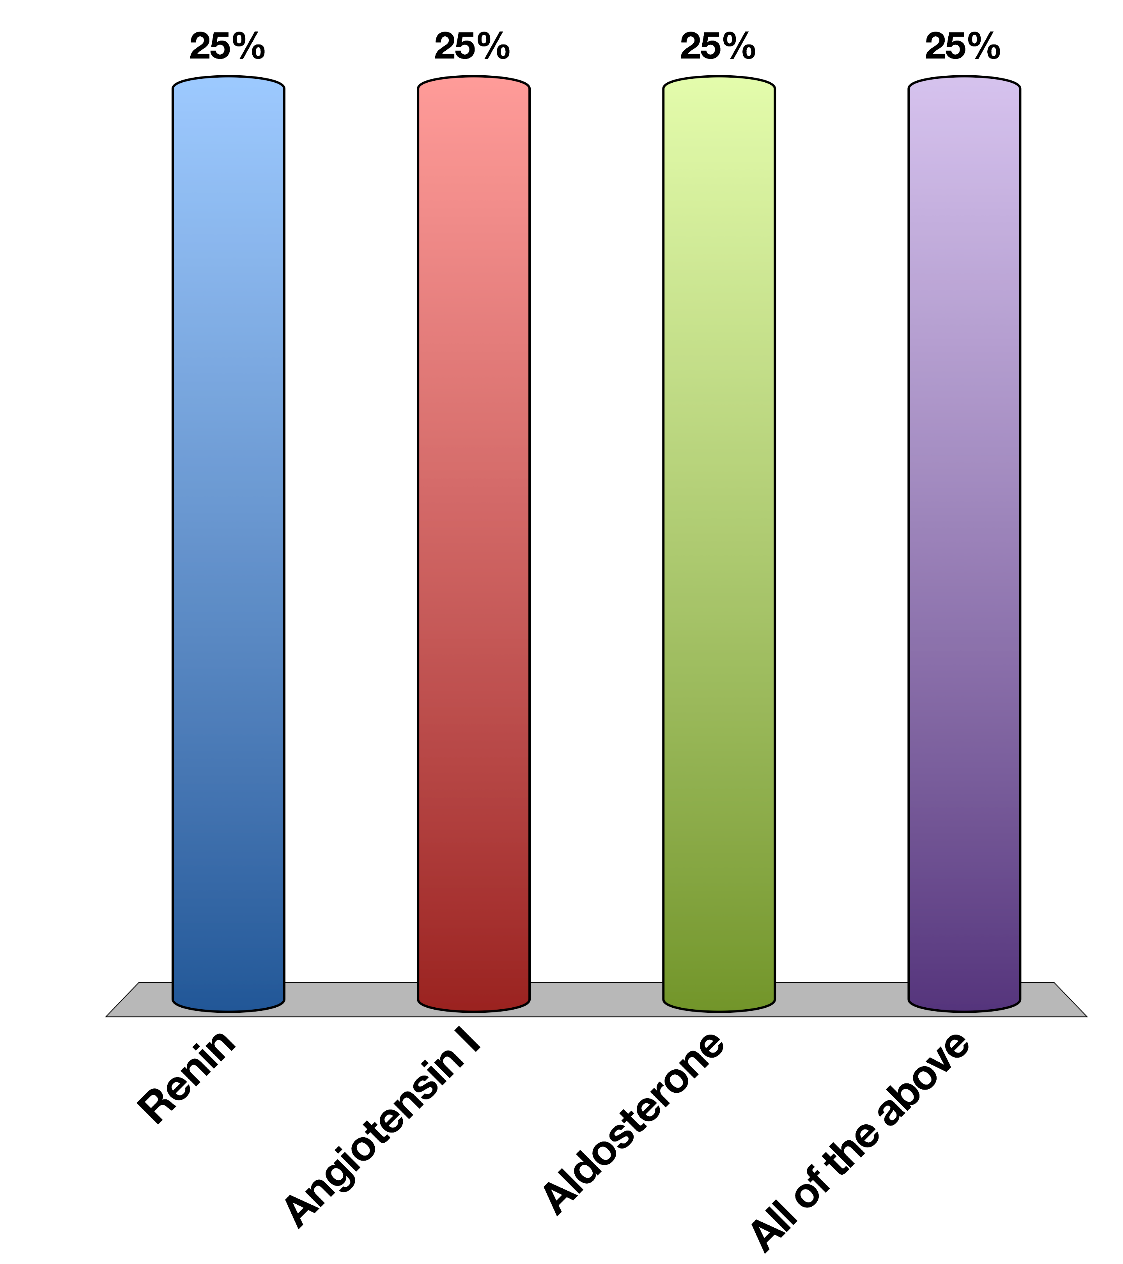
JG Cells Release What Factor?
Renin
Angiotensin I
Aldosterone
All of the above
15

Slide 6
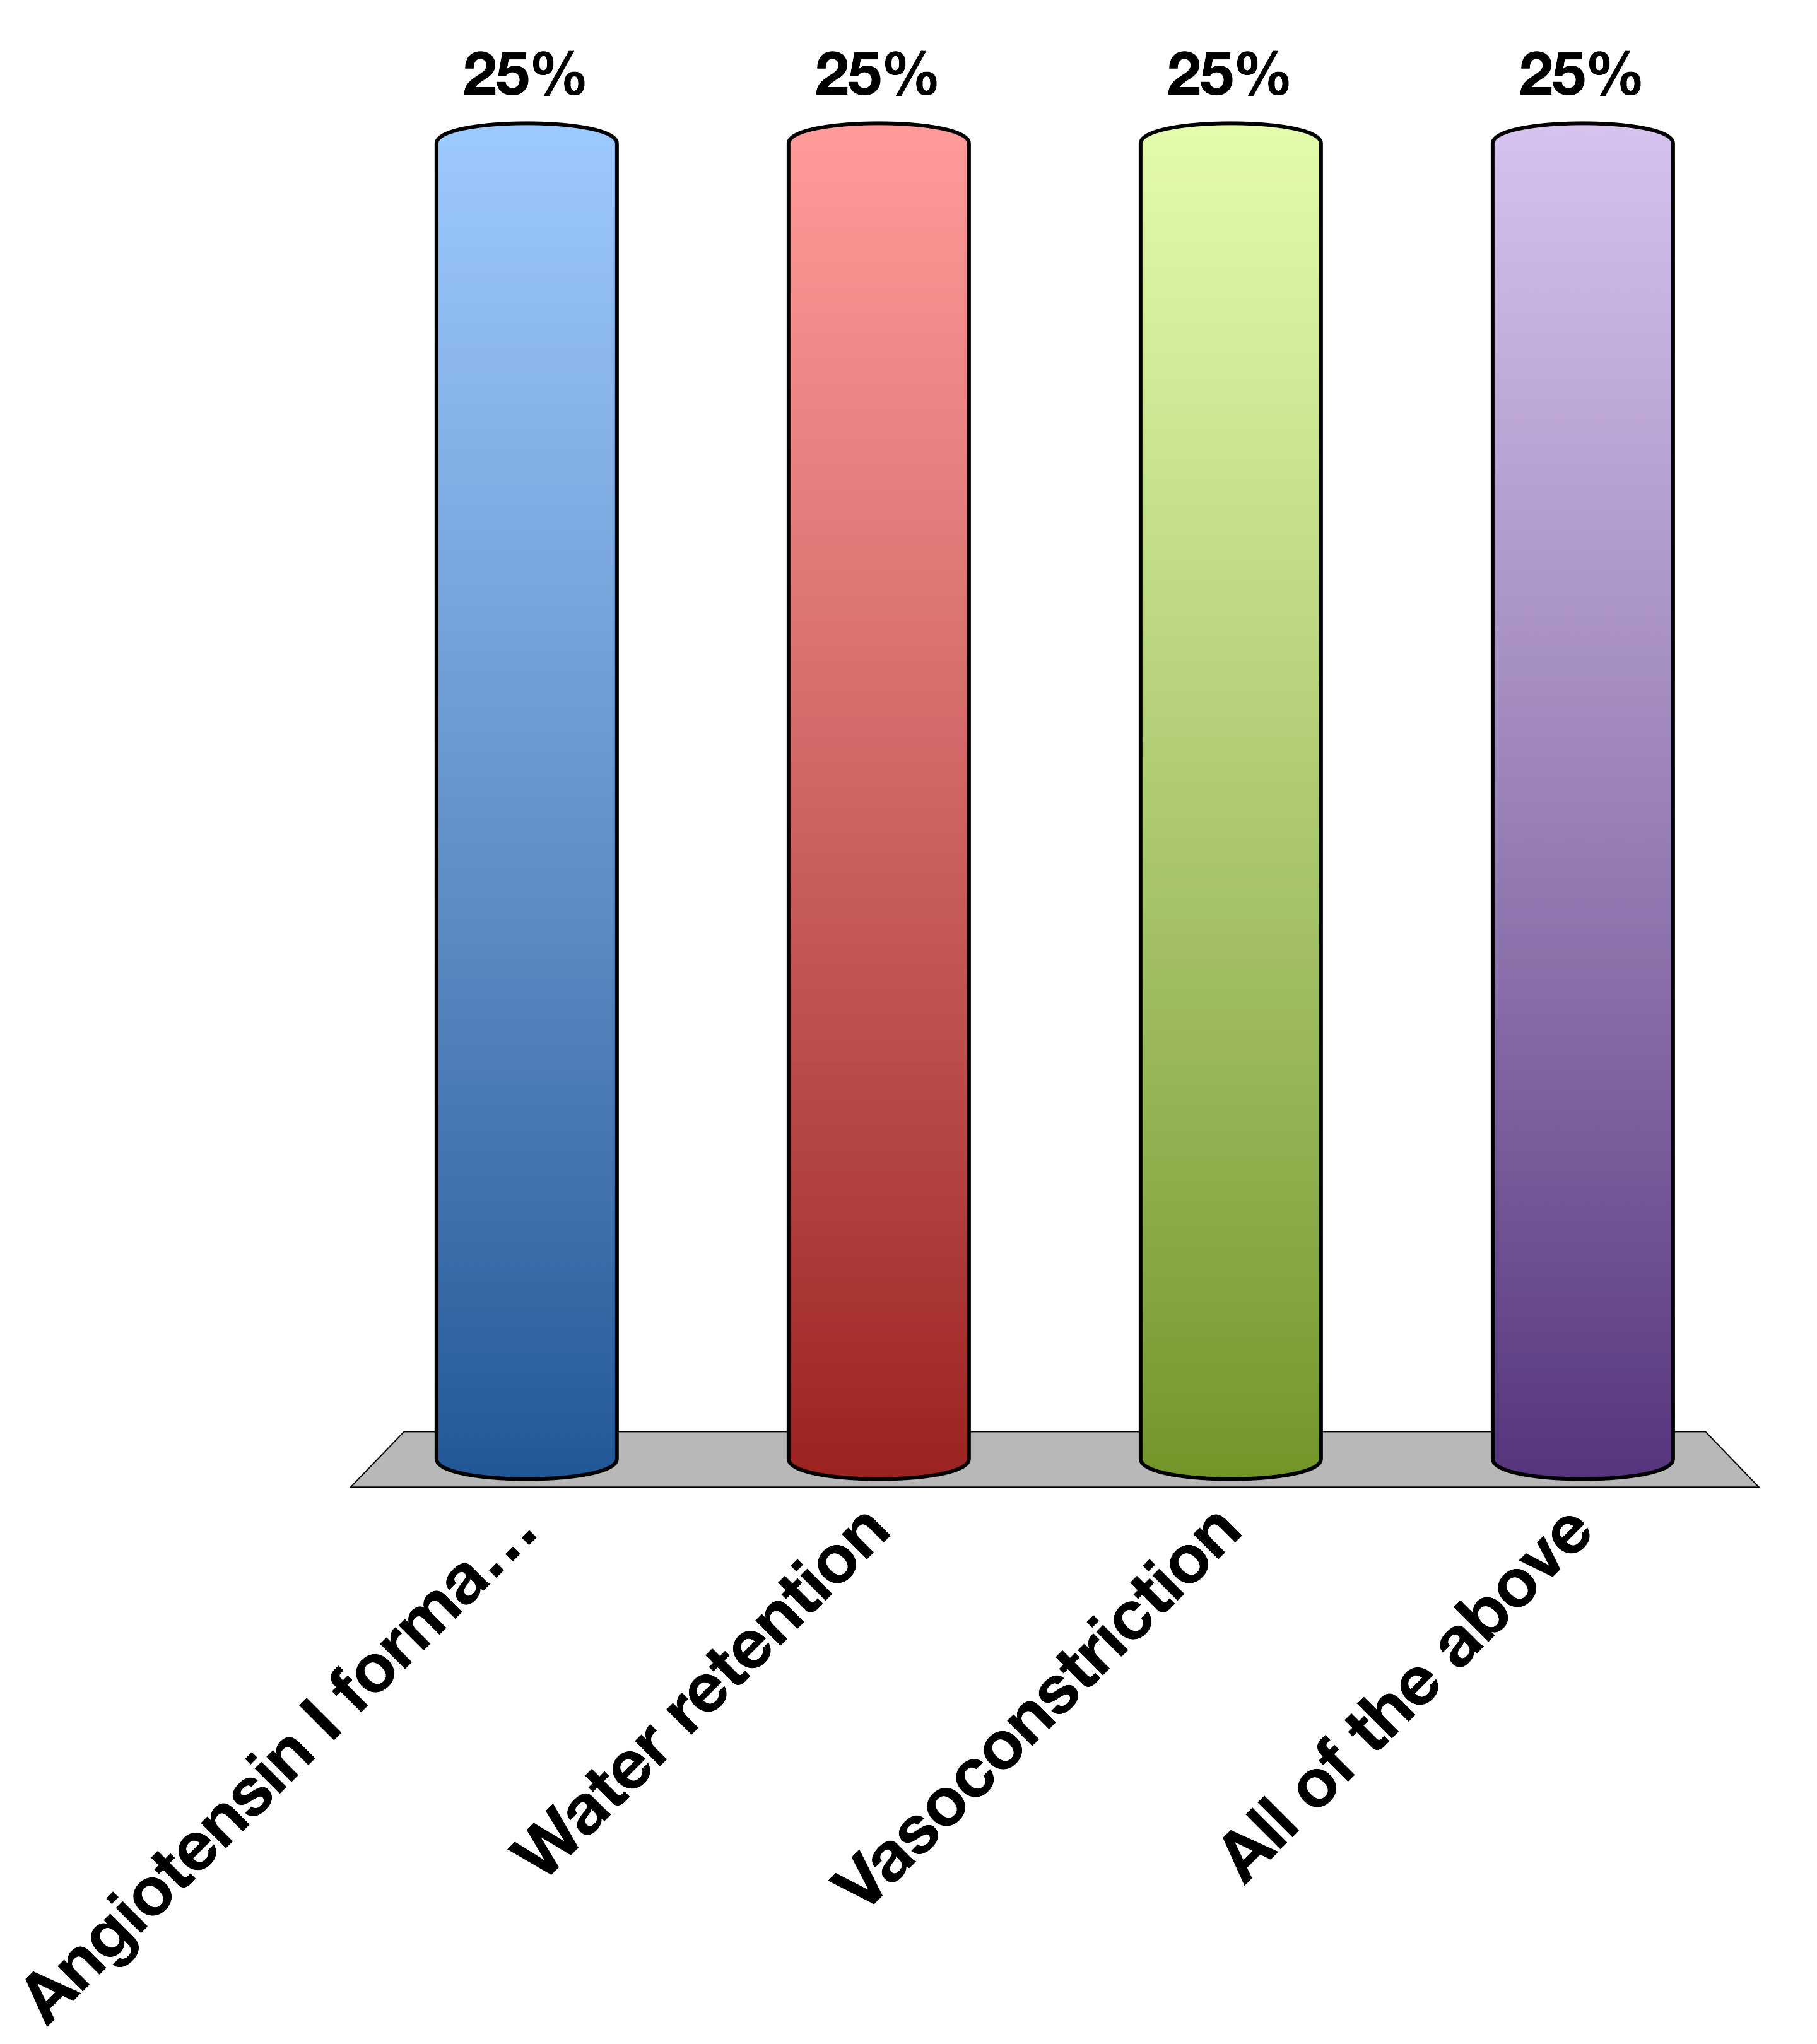
What is the end effect of activating the Renin/Angiotensin System
Angiotensin I formation
Water retention
Vasoconstriction
All of the above
15

Slide 7
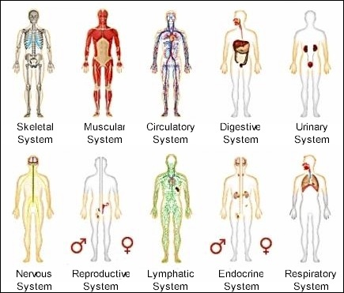
Organ Systems
Notes:
Most organ systems you are learning about in this series are physically connected organelles. These organelles evolved to have extremely important specialized functions, but in physiology these systems must be able to communicate with each other and the outside world

Slide 8
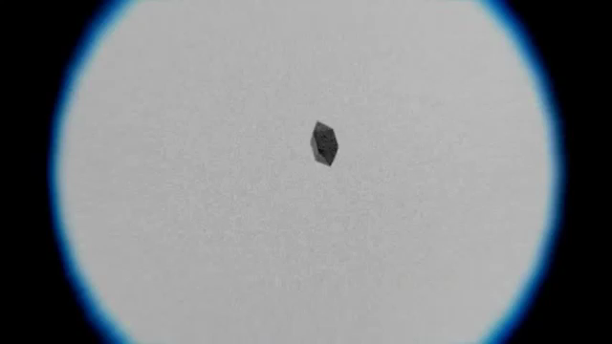
Extracellular Sensing
https://www.youtube.com/watch?v=F6QMU3KD7zw
Notes:
Bacteria chemotaxis around a sugar cube

Slide 9
What are the important processes?
There has to be a signal
That signal has to be detected
The cell has to respond to that signal
After a while the signal has to be stopped

Slide 10
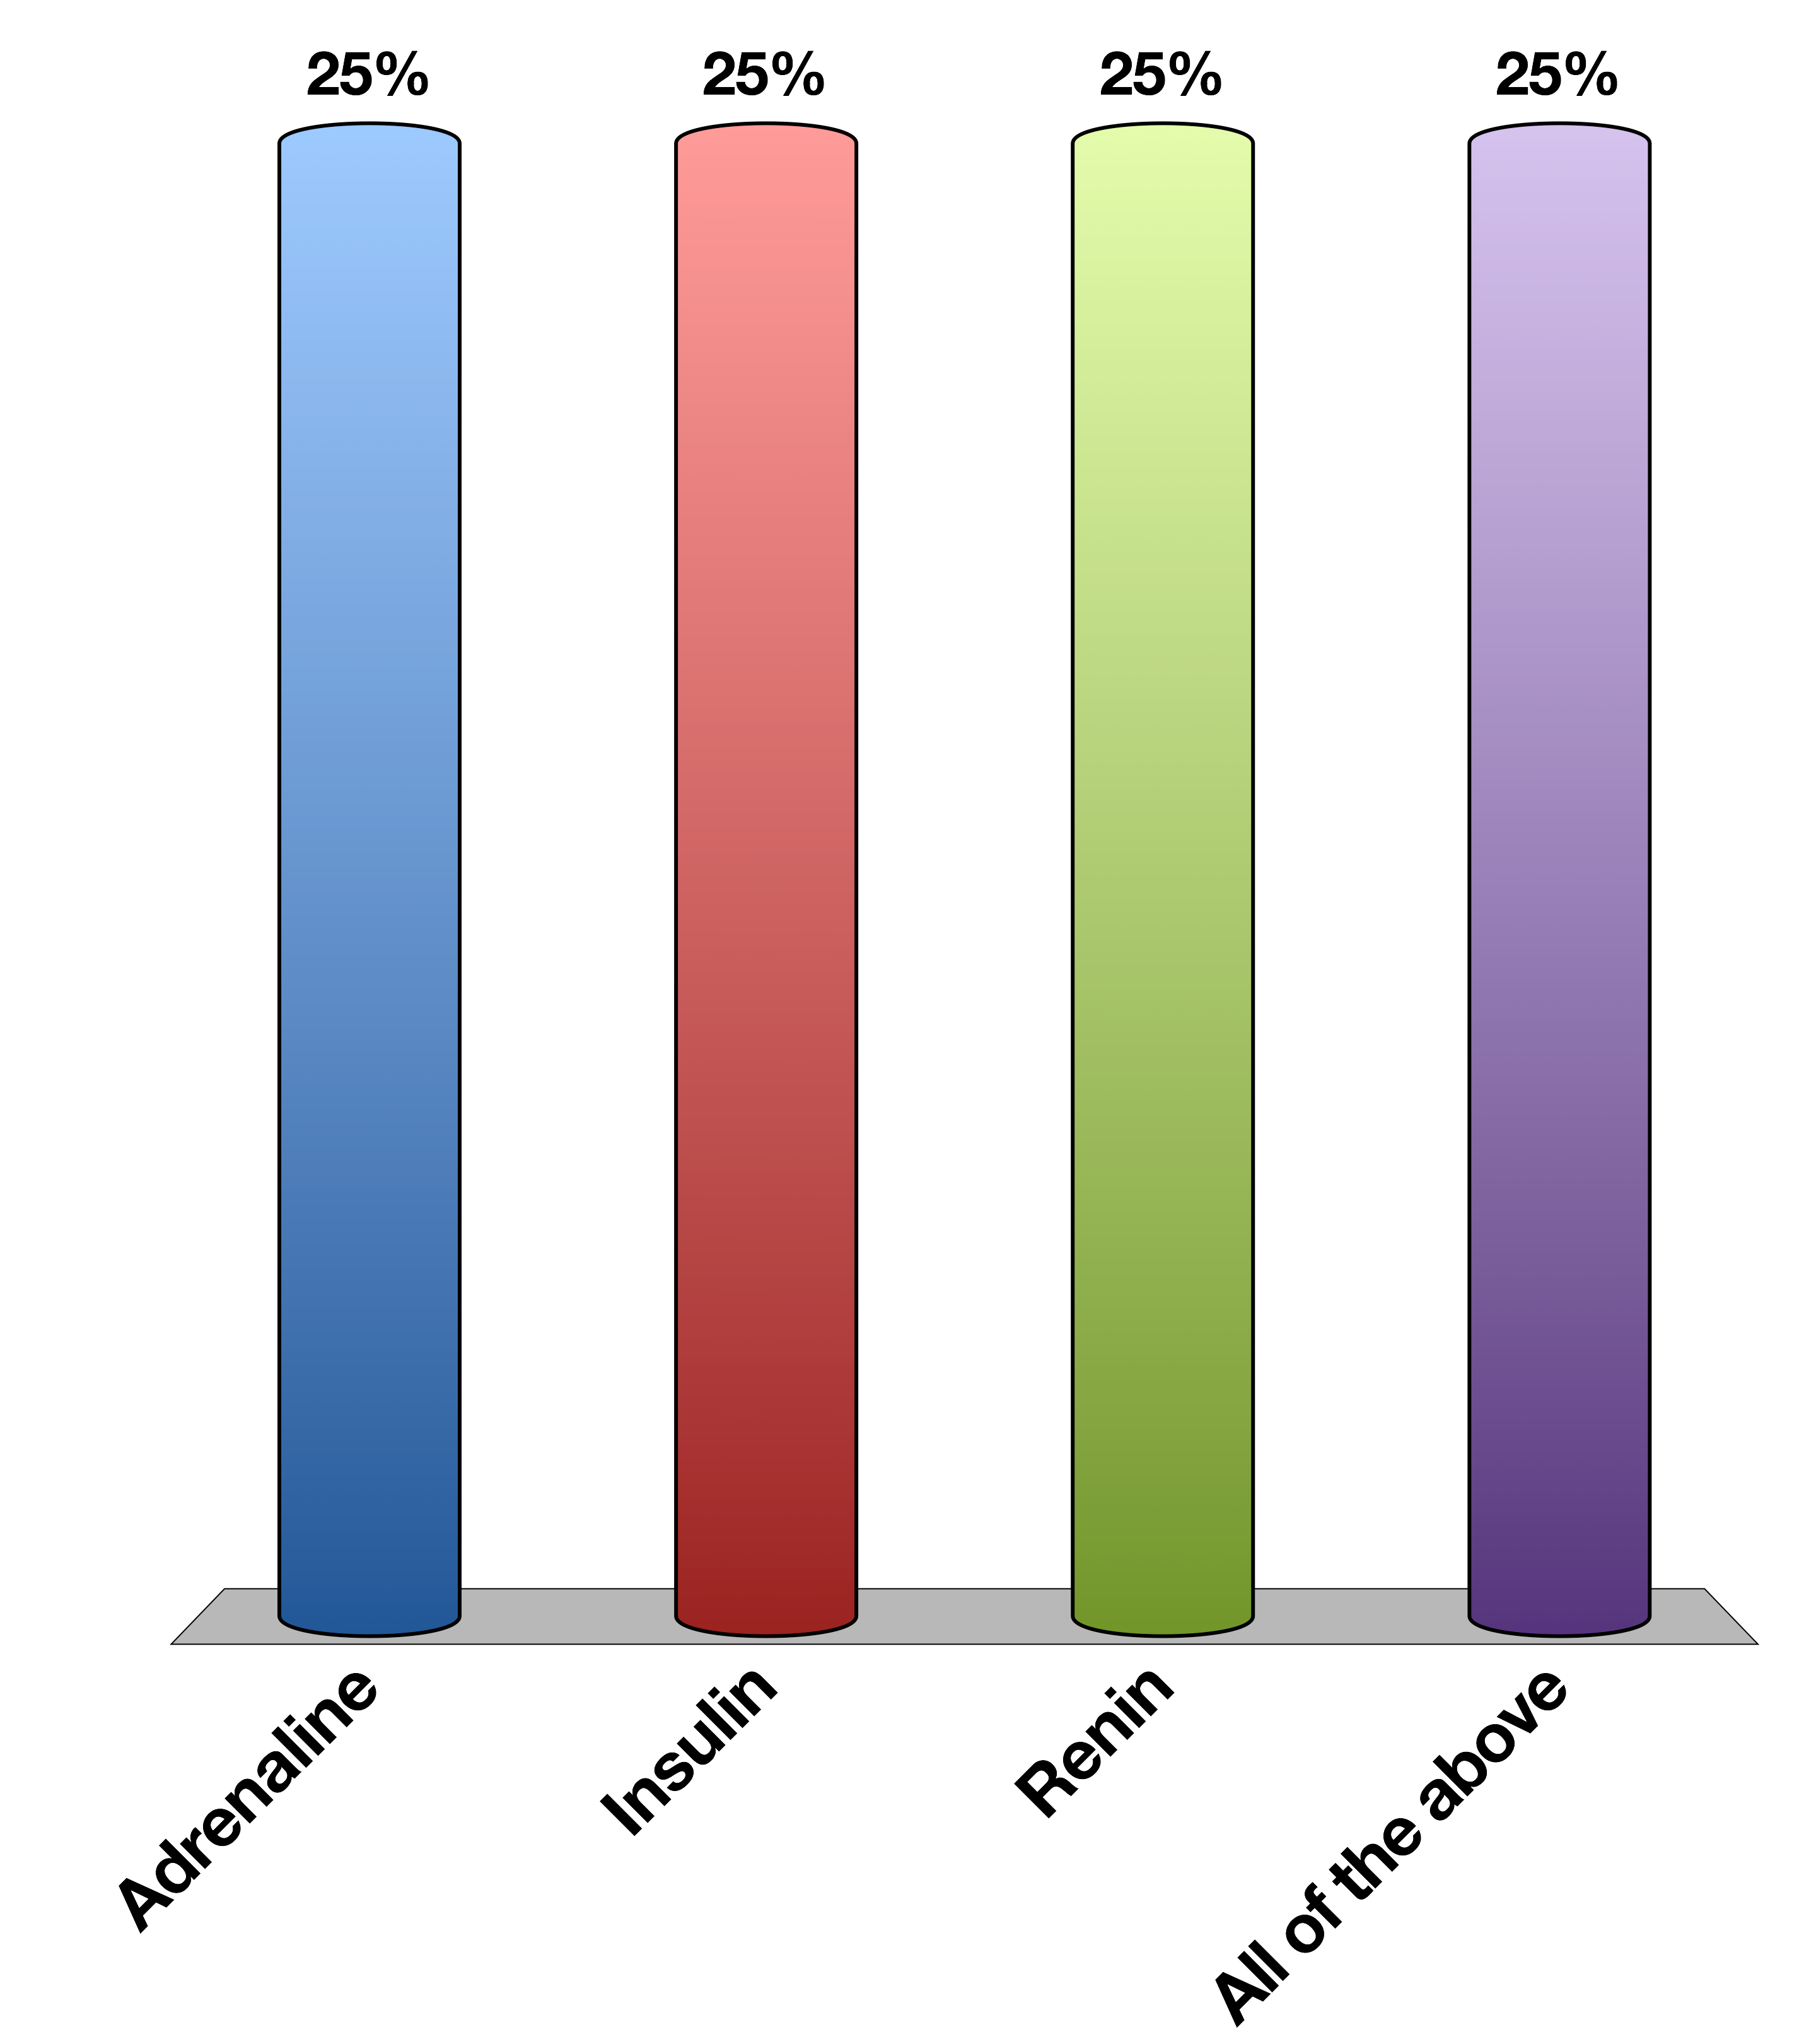
When fight or flight increases blood flow to muscles, what is the signal
Adrenaline
Insulin
Renin
All of the above
15

Slide 11
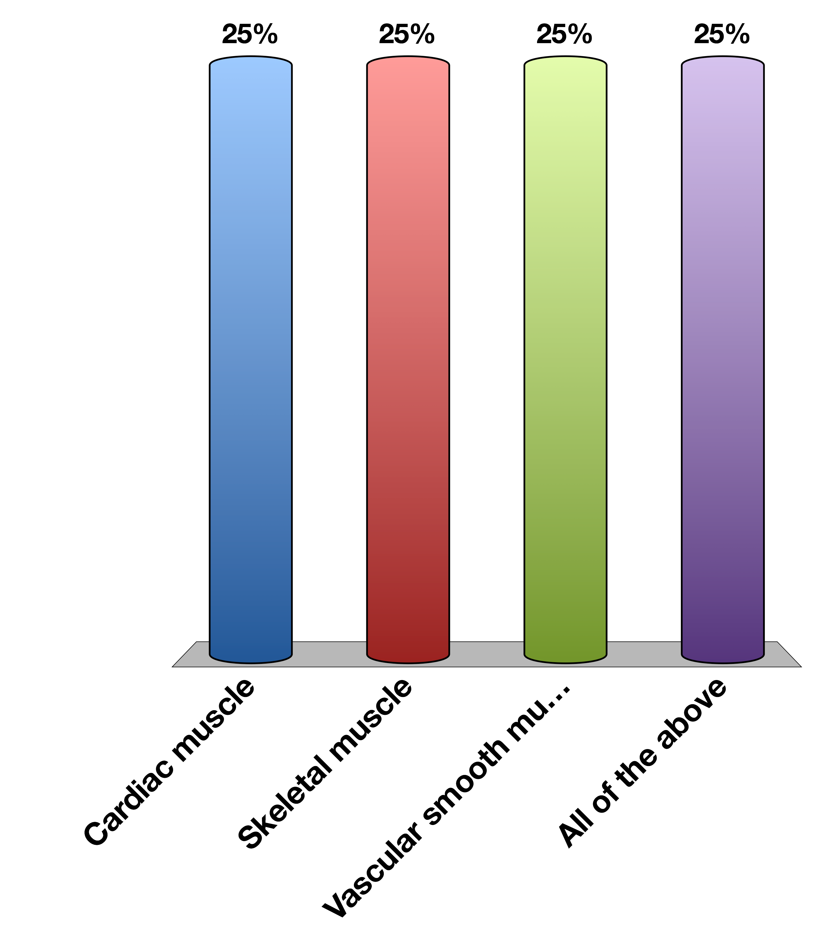
What cells respond to that signal
Cardiac muscle
Skeletal muscle
Vascular smooth muscle
All of the above
15

Slide 12
Every Hormone is Simple
Where is it made?
What causes its release?
What are its receptors?
What tissues does it effect?
How does it get turned off

Slide 13
Example Adrenaline
Where is it made? | Adrenal medulla
What causes its release? | Sympathetic nervous stimulation
What is its receptor? | Alpha/Beta-Adrenergic Receptors (5 subtypes) | GPCR -> Gs and Gi
What tissues does it affect? | Heart | Increased heart rate
 | Lungs | Increased respiration
 | Vasculature | Vasoconstriction (smooth muscle), vasodilation (skeletal muscle)
 | Liver | Glycogenolysis
 | Fat | Lipolysis
 | Skeletal Muscle | Contraction
How does it get turned off? | Sympathetic signal stops

Slide 14
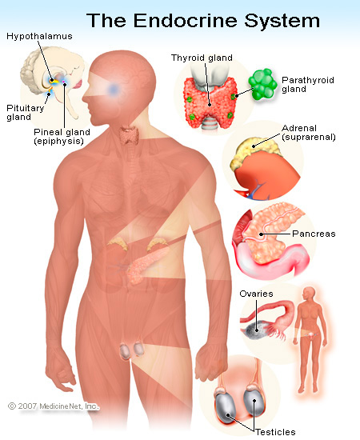
Generally, where are hormones made
Notes:
Total oversimplification as hormones are now known to be made in many other tissues (gut/fat/muscle)

Slide 15
Generally how are hormones released?
Nervous stimulation
Adrenaline, CRH, TSH
In Response to Another Hormone
Cortisol (ACTH), Thyroid Hormones (TSH)
In Response to A Metabolite
Insulin, Glucagon, Calcitonin
In Response to Physical Changes Such As Stretch
Ghrelin, Renin
Notes:
Calcitonin responds to elevated calcium

Slide 16
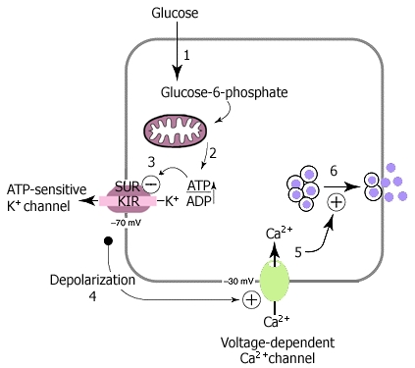
Insulin Release In Response To Glucose

Slide 17
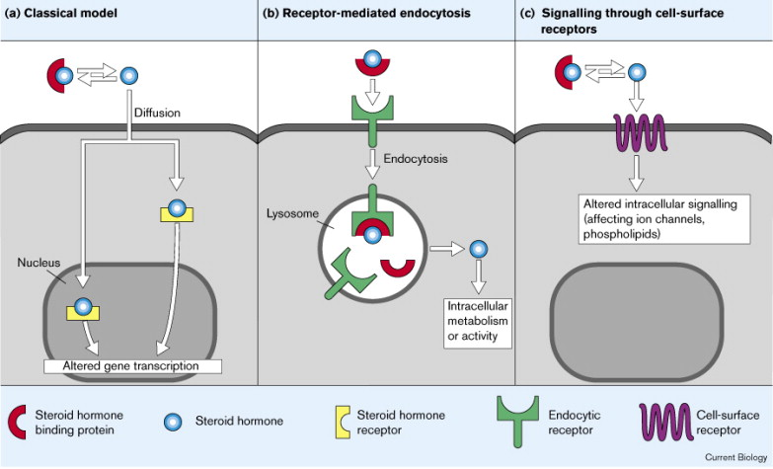
Broadly What Kinds of Receptors Are There?

Slide 18
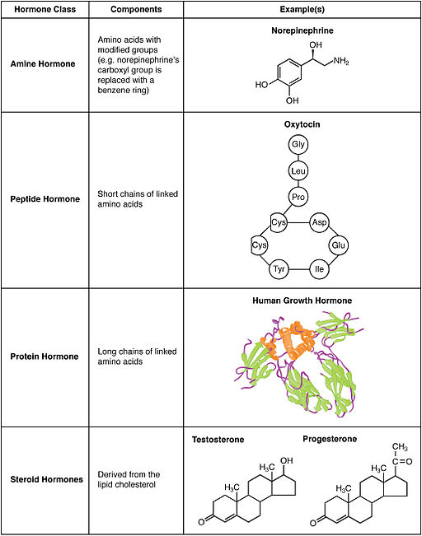
What Kinds of Hormones Are There?
Notes:
Note size of human growth hormone

Slide 19

Which hormone type is most likely to be able to cross plasma membranes
An amine such as adrenaline
A peptide such as insulin
A polypeptide such as FSH
A steroid such as testosterone
15

Slide 20
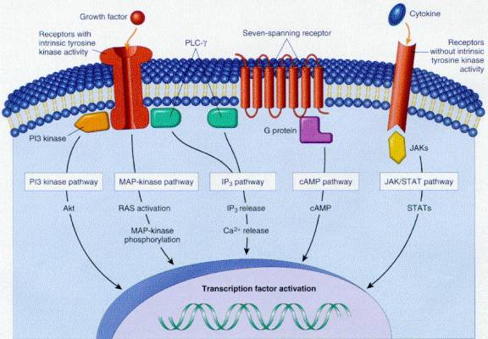
Cell Surface Receptors

Slide 21
Types of Cell Surface Receptors
GPCRs
Receptor Tyrosine Kinases
JAK/STAT Receptors
7-TM
Activates G proteins in several classes
Can regulated cAMP, Ca, DAG and RhoGTPases
Example BAR
1-TM (dimer)
Autophosphorylate on tyrosine residues
Recruits and activates effectors like Akt
Example InsR
1-TM (dimer)
Recruits kinase (JAK) which phosphorylates effectors (STAT)
pSTAT activates gene transcription
Example GH

Slide 22
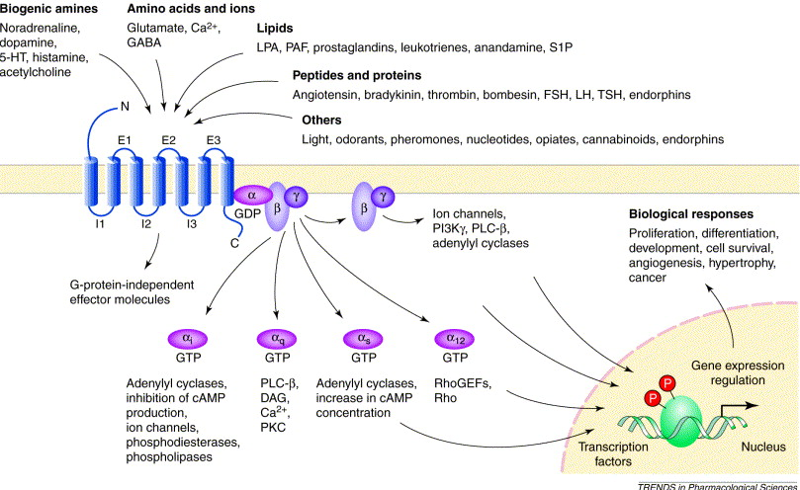
GPCRs

Slide 23
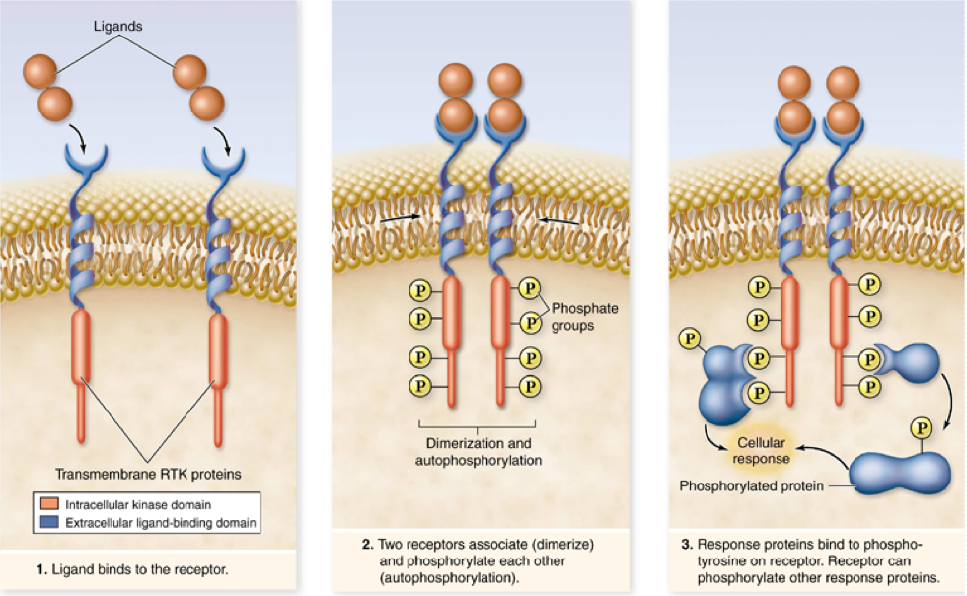
Receptor Tyrosine Kinases

Slide 24
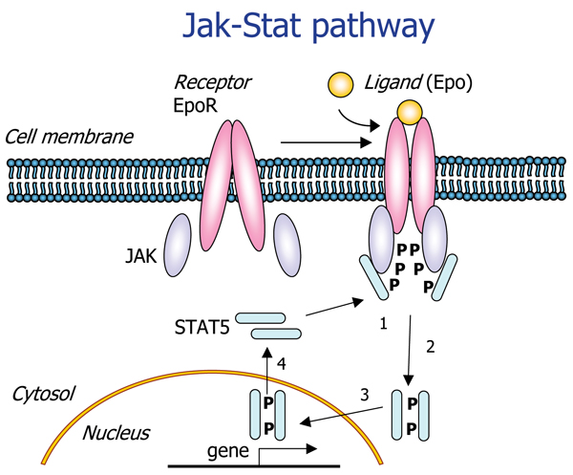
JAK/STAT Receptors

Slide 25
Nuclear Hormone Receptors

Slide 26
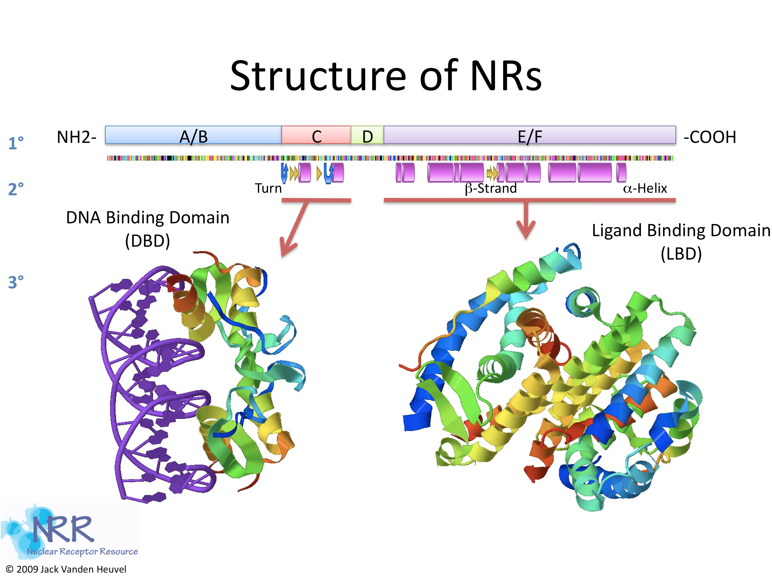
What Do Nuclear Hormones Look Like?

Slide 27
Group Activity
What are some differences in nuclear hormone receptors vs cell surface receptors
What has to be different about the ligands
What has to be different about the responses

Slide 28
General Concepts About Hormone Targets
How does the hormone get from A -> B
Is it released into the blood?
Does it require accessory proteins to help keep it soluble?

Slide 29
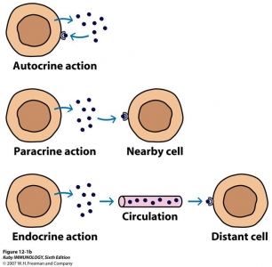
Relative Location of Action

Slide 30
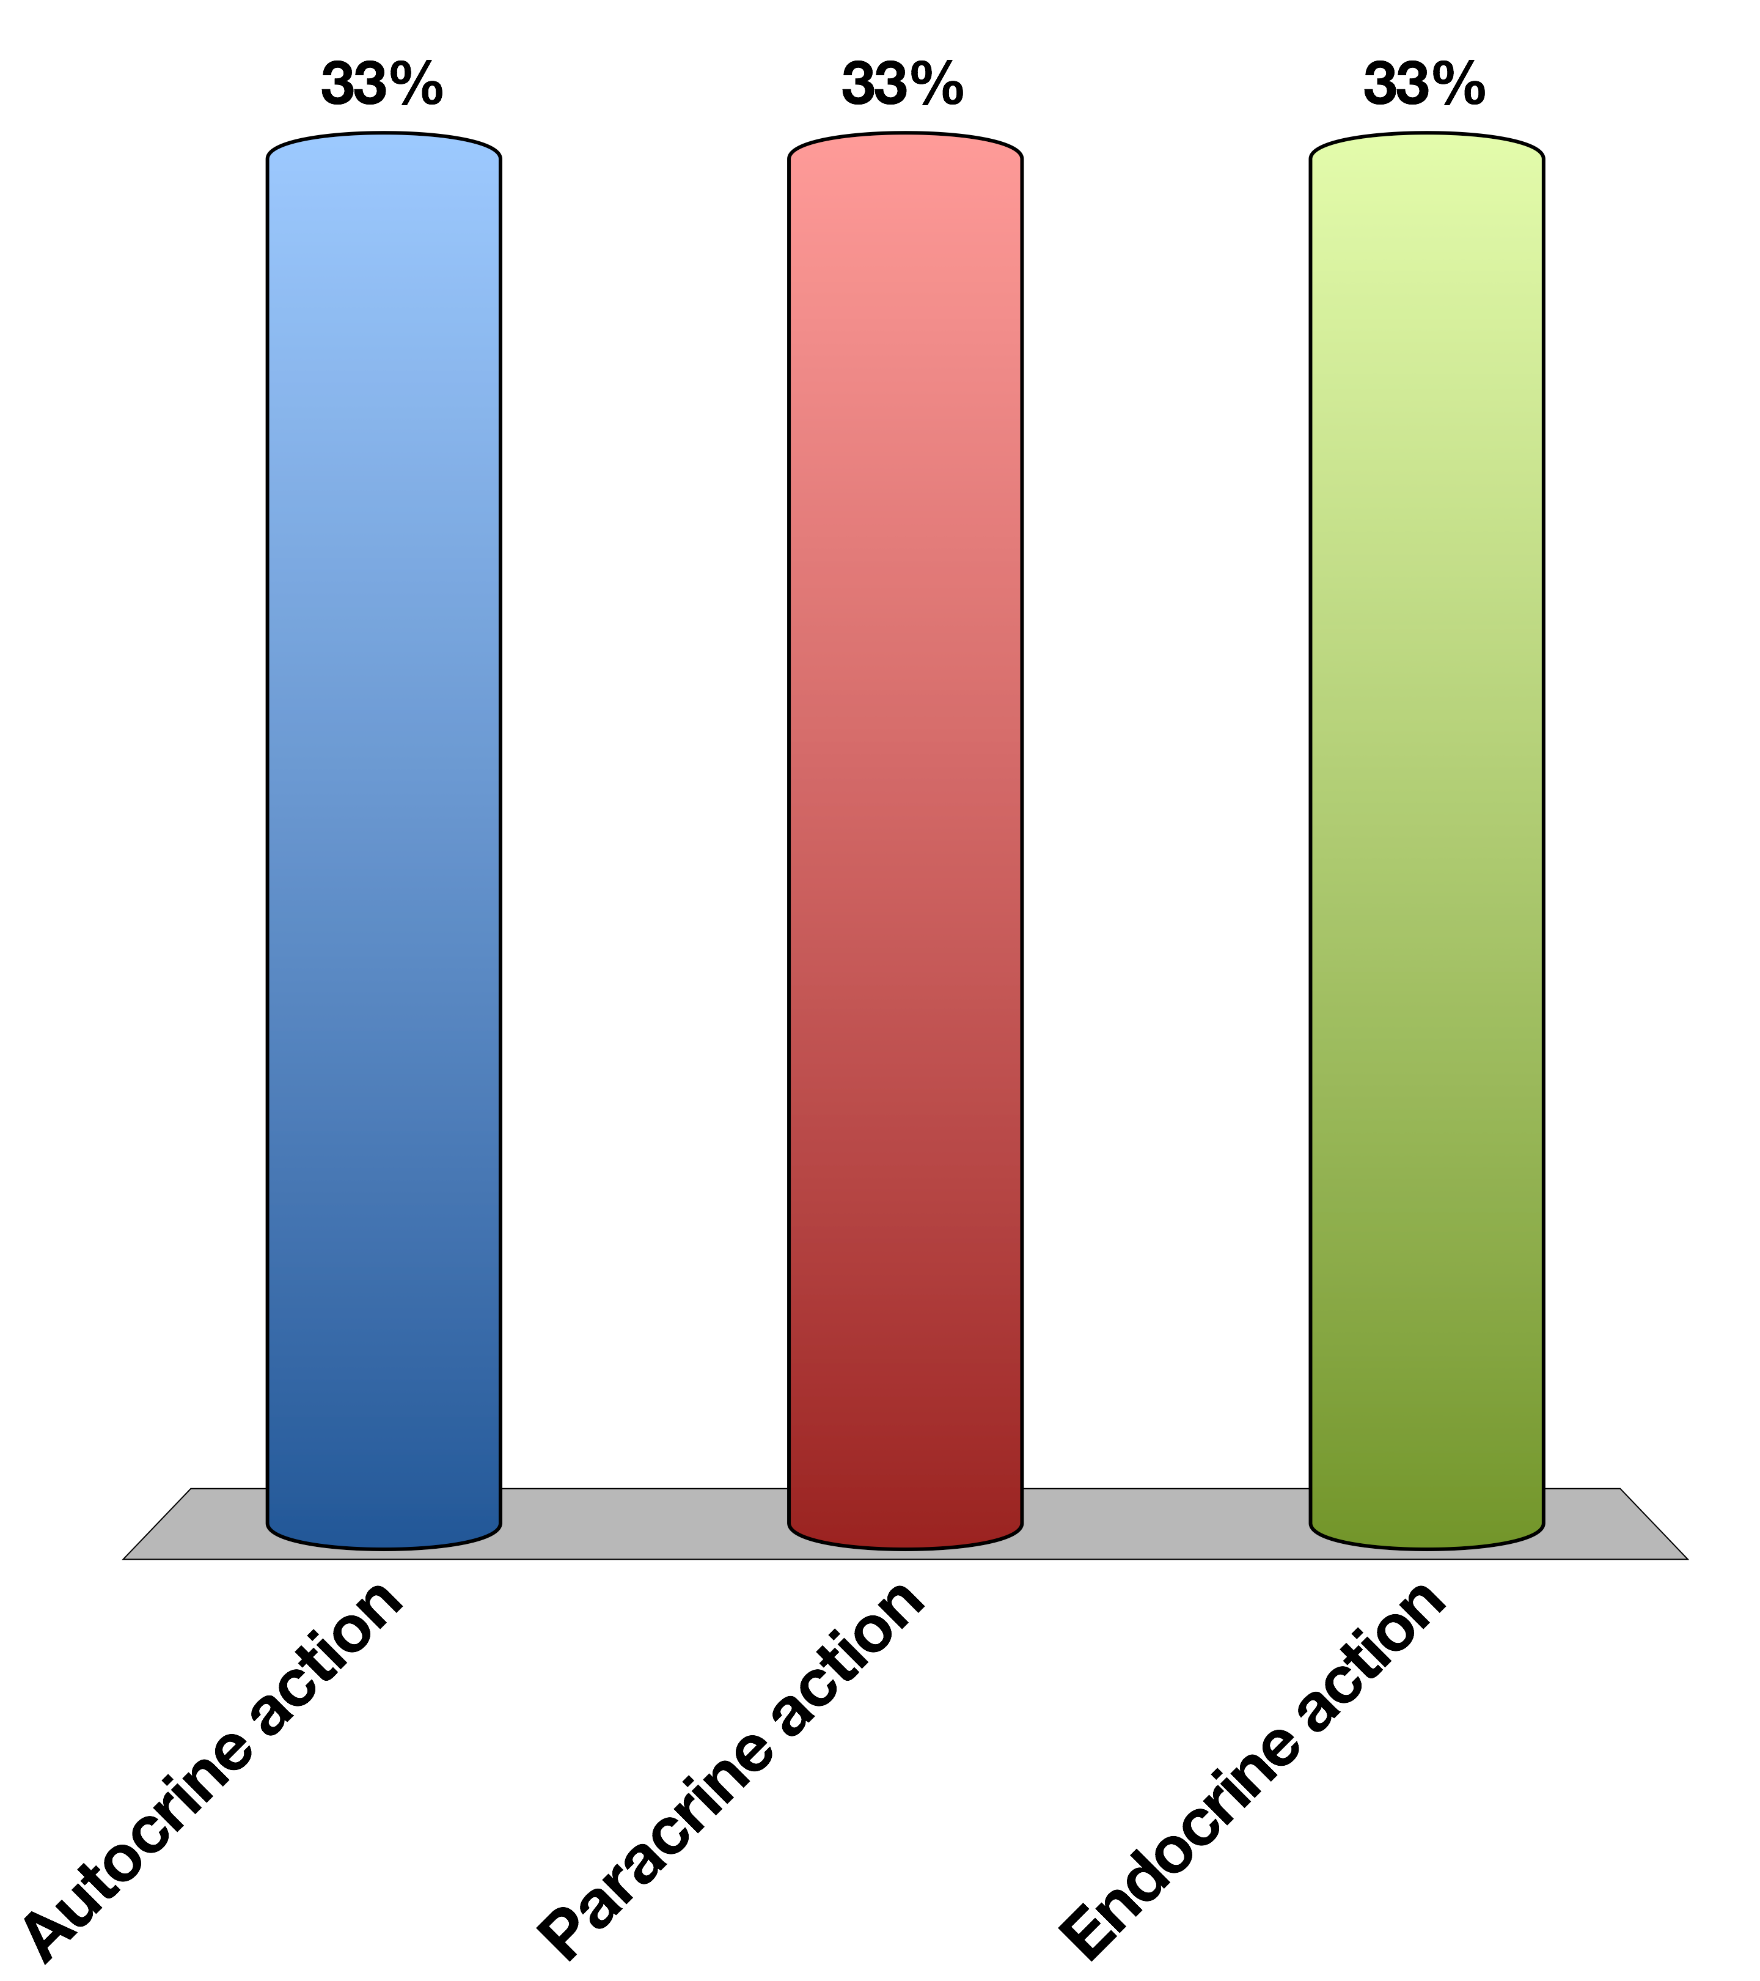
Insulin is released from pancreatic beta cells and is sensed by pancreatic alpha cells to reduce glucagon secretion. This is an example of …
Autocrine action
Paracrine action
Endocrine action
15

Slide 31
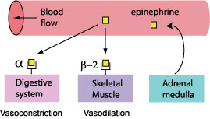
How To Get Hormonal Specificity?
Restrict the location of the hormone release (ie neurotransmitters only released into synapse)
Restrict the receptors to particular tissues
Have the receptors mediate different processes in different cell types
For more details see O’Connell’s lectures on blood pressure regulation

Slide 32
Turning the Signal off
Induce hormone resistance at the target cell
Prevent further hormone production and/or reduce the levels

Slide 33
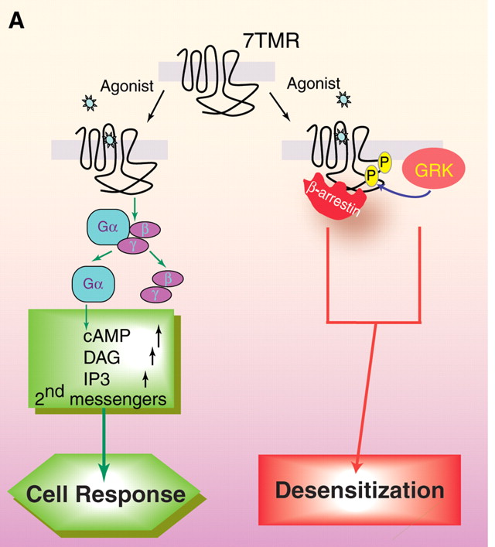
Example: Arrestins and GPCRs
Lefkowitz RJ, Shenoy SK (2005) Transduction of receptor signals by beta-arrestins. Science 308: 512–517. doi:10.1126/science.1109237.

Slide 34
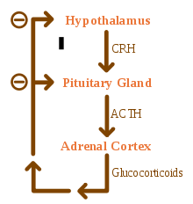
Example: Reduce New Hormone Secretion

Slide 35
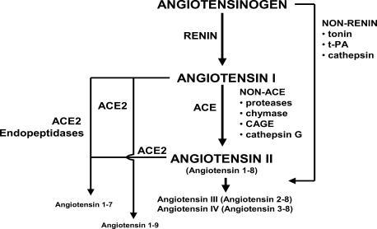
Example: Degrade Existing Hormones

Slide 36
Group Project
Pick some hormone that you think you know of its function
Imagine a patient that has no negative feedback to that hormone. What happens and why?
Now imagine another patient that has way too much negative feedback to that hormone. What happens and why?

Slide 37
Integration of the CNS with Endocrine Signals
In Response To CNS
To Modify CNS
Externally sensed cues (ie, look a bear!)
Release of adrenaline
Modify peripheral responses
Internally sensed cues (ie, my stomach is full)
Feeding hormones (Leptin, Ghrelin, PYY)
Modify behavior

Slide 38
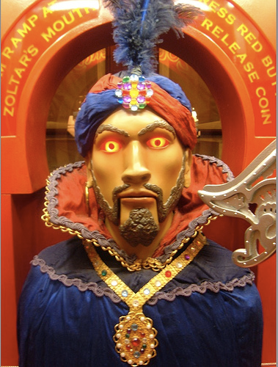
Your Future
Endocrine Control Systems
Neuroendocrinology and the Posterior Pituitary
Hypothalamus and Endocrine Control of Appetite
Endocrine Control of Growth
Adrenals and Stress Hormones
Pancreatic Hormones and Metabolic Control
Thyroid Hormones (KP)
Calcium Homeostasis (MF)
Reproductive Hormones (HP)

Slide 39
Design a hormone
What process does it govern?
What signals its release? Does it result from external cues, or internal cues?
Under what time-scale does this change occur?
What should end the signaling event?
What would be the pathophysiology of this hormone not existing? How about being far too active?

Slide 40
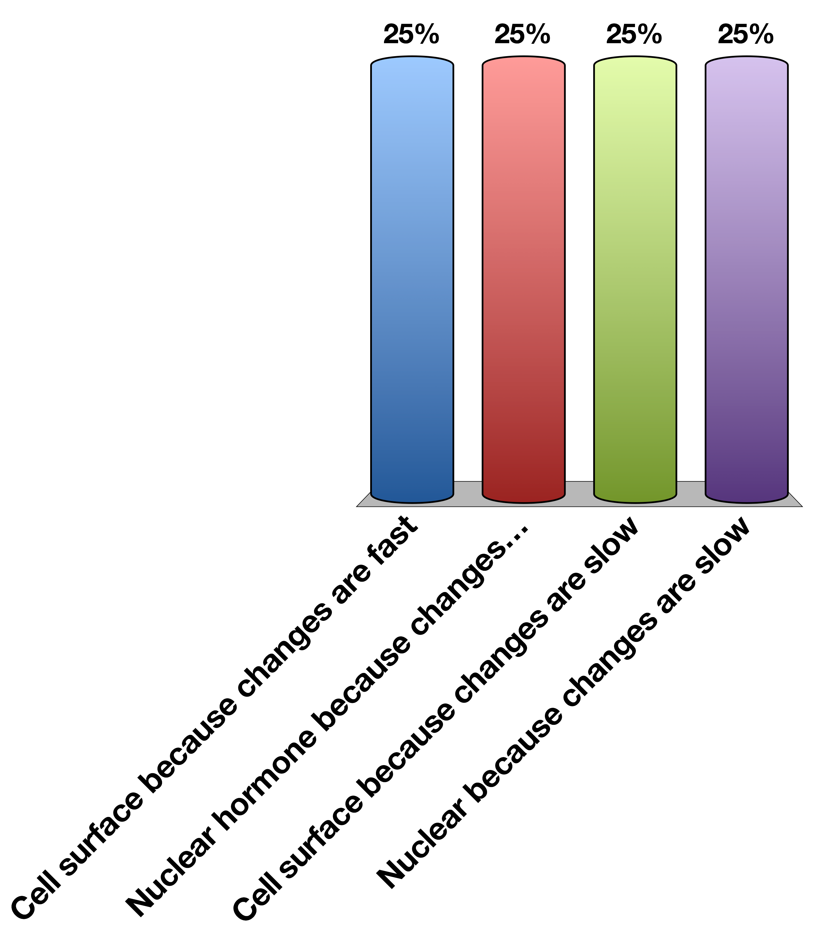
What is the most likely receptor?
Cell surface because changes are fast
Nuclear hormone because transcriptional changes are fast
Cell surface because changes are slow
Nuclear because transcriptional changes are slow
15

Slide 41
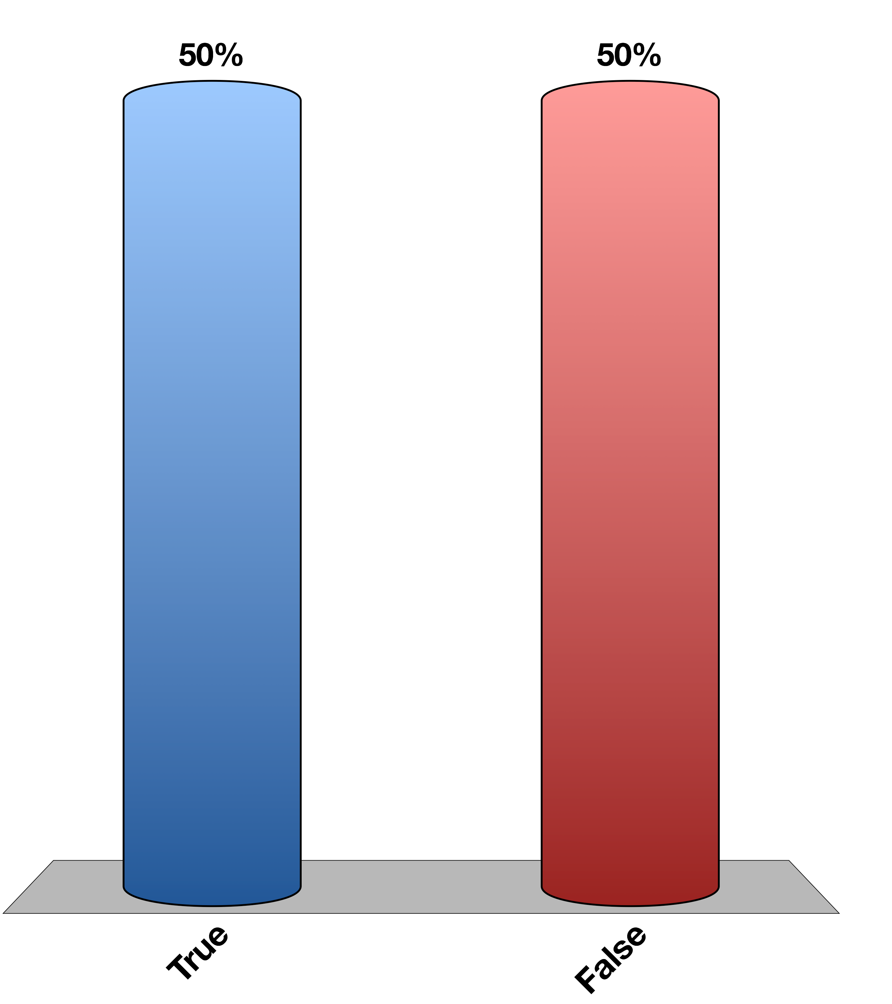
Is this a neurendocrine hormone
True
False
15

Slide 42
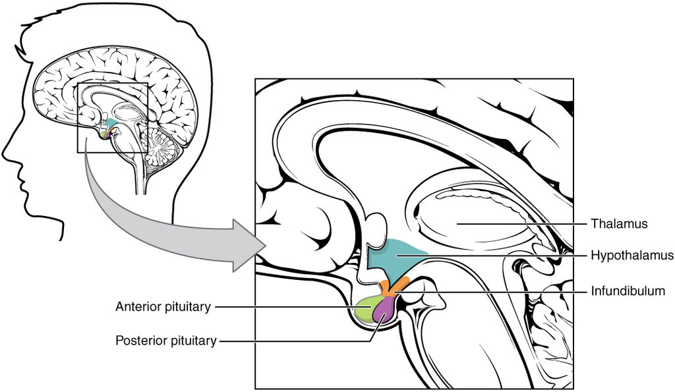
The Hypothalamus Is the Main Site of Endocrine/CNS Integration

Slide 43
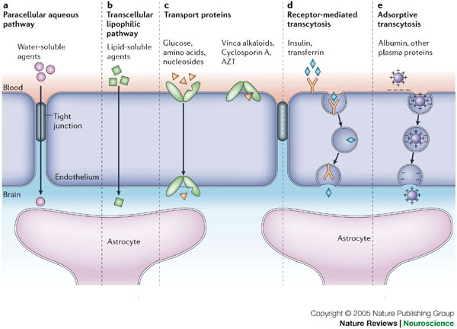
How Are Hormones Sensed by the Hypothalamus?

Slide 44
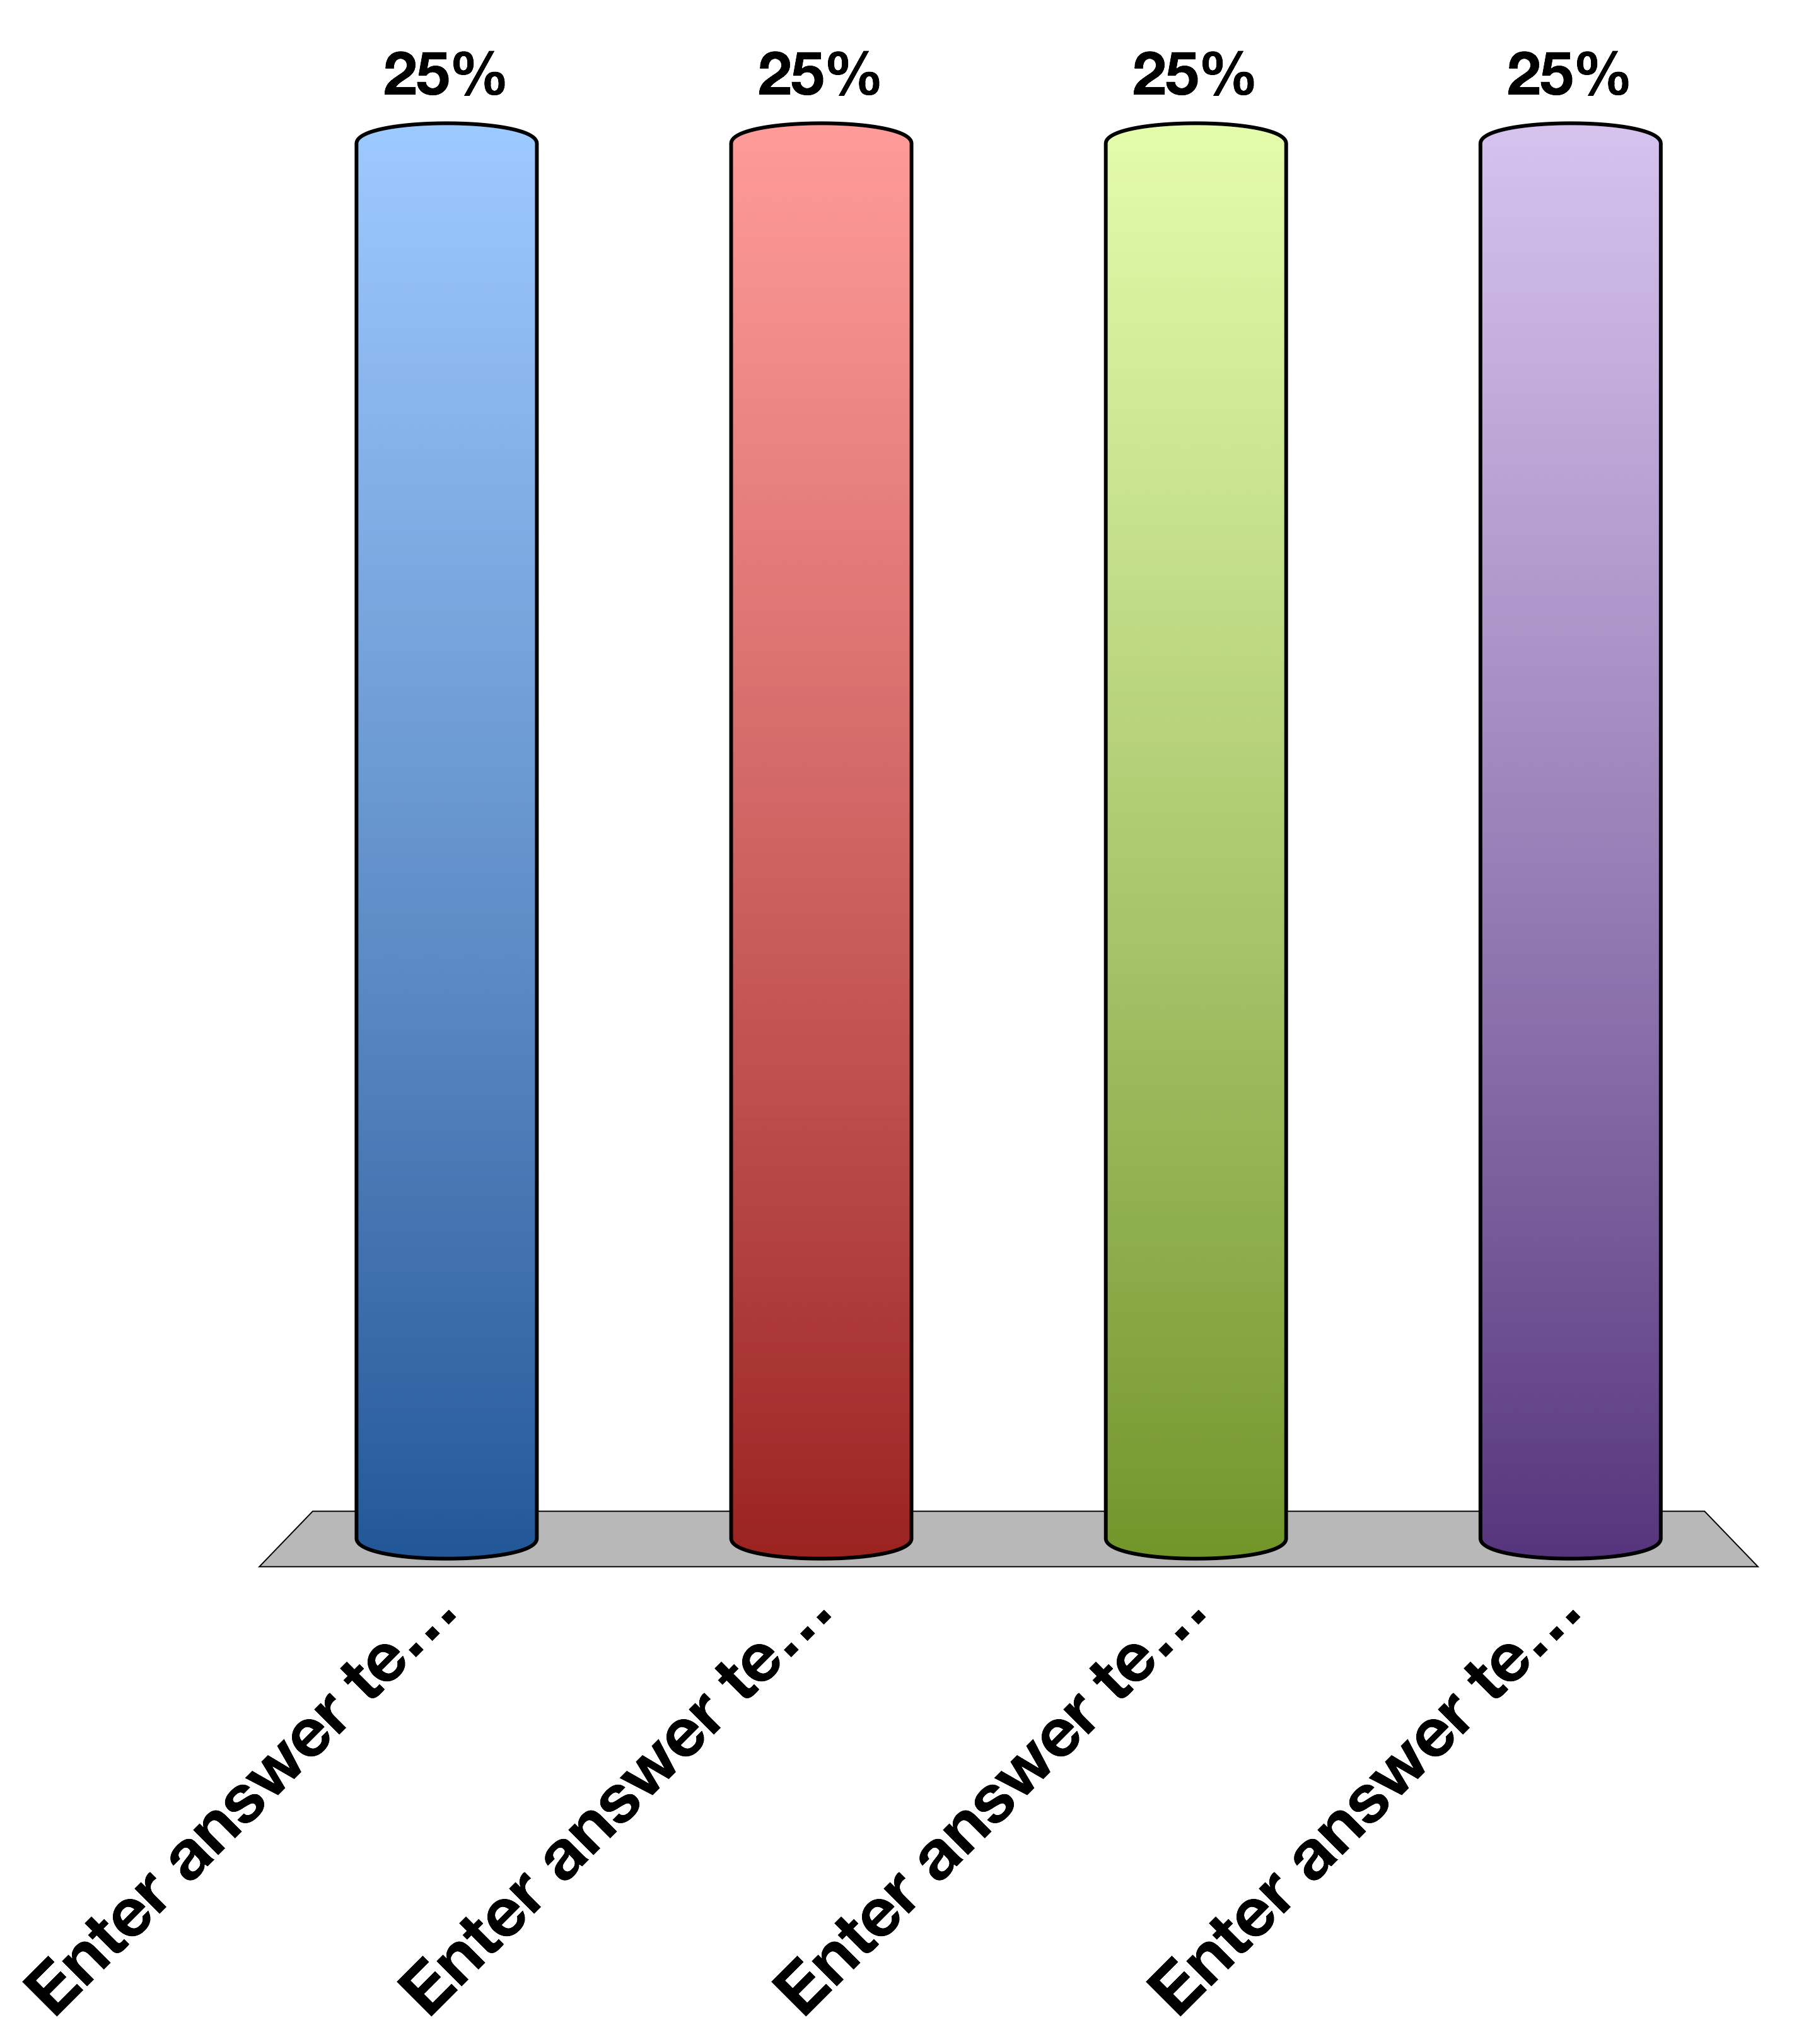
Which hormone is unlikely to be BBB-permeable without transport
Adrenaline
Cortisol
Growth Hormone
All of the above
15

Slide 45
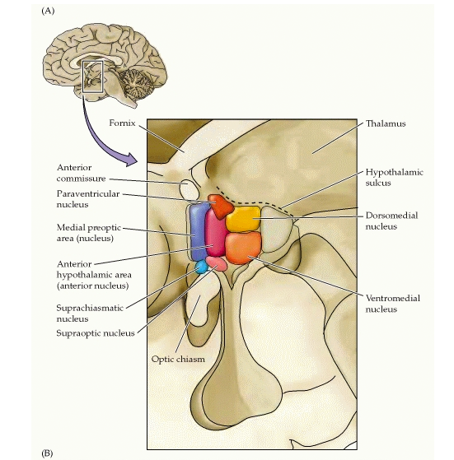
Subregions of the Hypothalamus

Slide 46
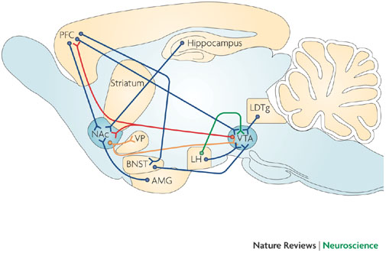
The Hypothalamus Projects to and From Other Brain Regions
Kauer JA, Malenka RC (2007) Synaptic plasticity and addiction. Nat Rev Neurosci 8: 844–858. doi:10.1038/nrn2234.
Notes:
LH is lateral hypothalamus
VTA is in midbrain
AMG is amygdala
PFC is prefromtal cortex

Slide 47
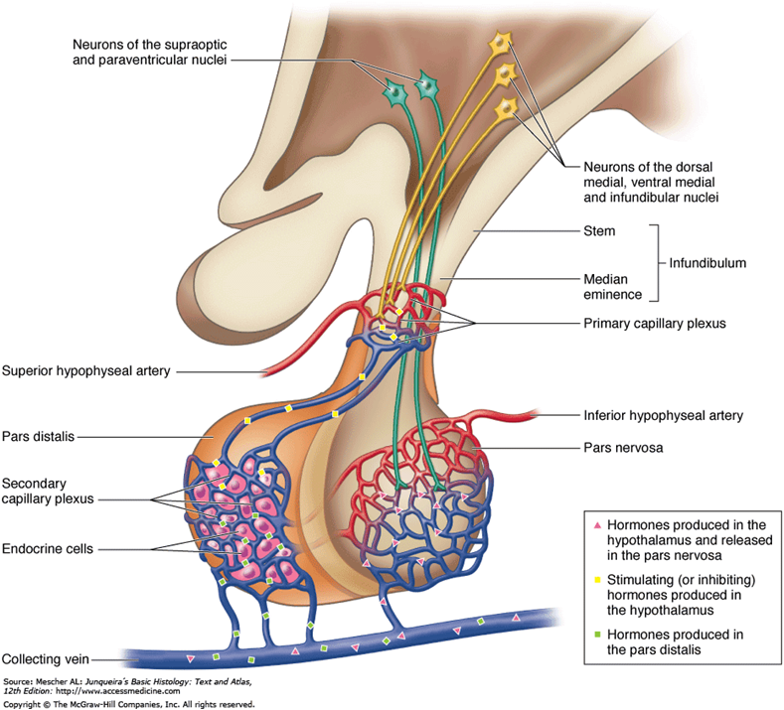
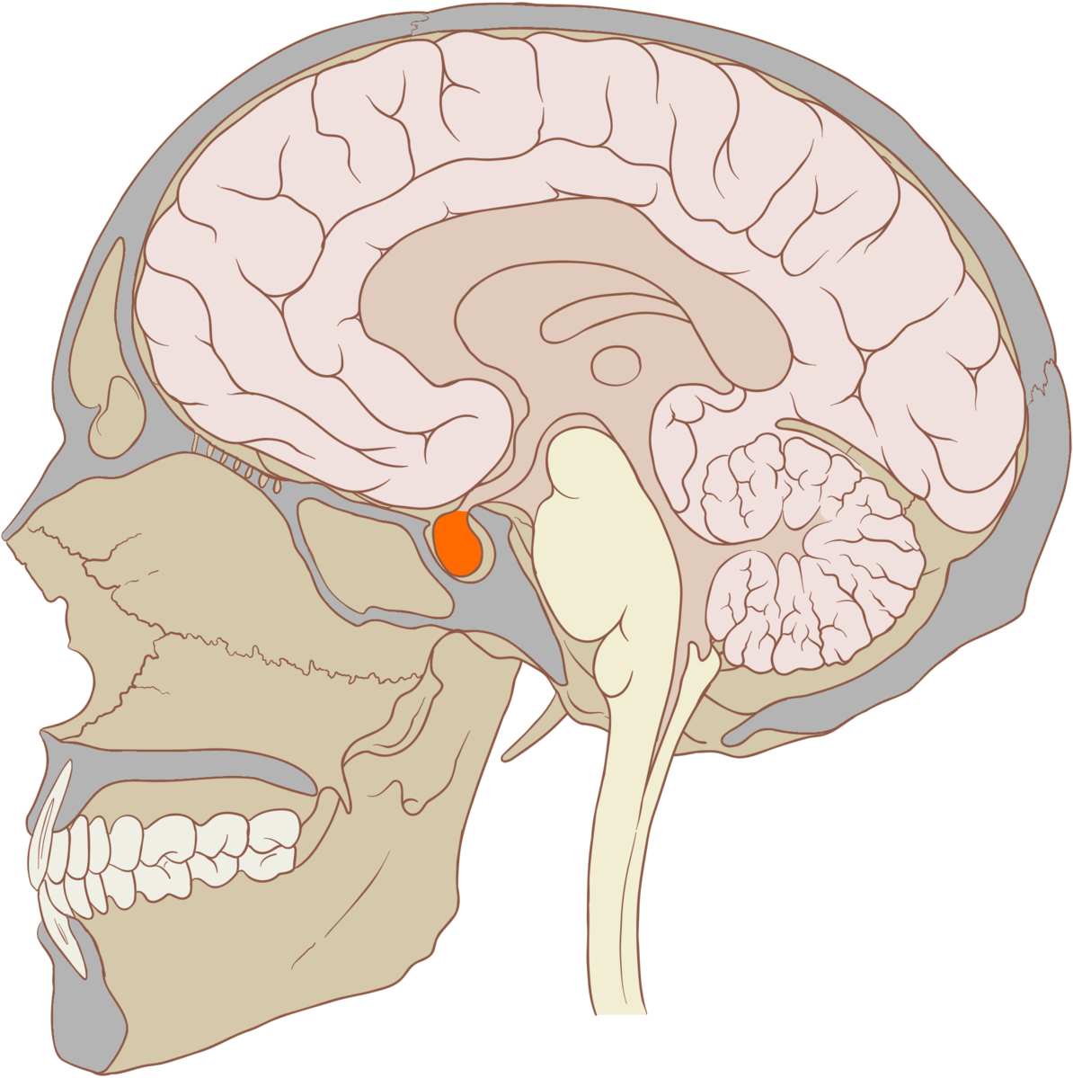
Anatomy of the Pituitary
Notes:
Anterior pituitary is connected to the hypothalamus by capilaries called the hypophyseal portal system
Posterior pituitary is connected to the hypothalamus by neurons
Both can secrete hormones directly into the circulation

Slide 48
The posterior pituitary is connected to the hypothalamus by neuronal contacts
True
False
15

Slide 49
The hypothalamus wants to direct the anterior pituitary to secrete ACTH. How would this be done
Hypothalamic neurons project to ACTH releasing cells
Hypothalamic neurons release a ACTH-releasing hormone
Neither A nor B
Both A + B
15

Slide 50
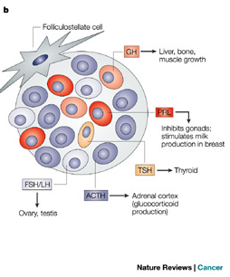
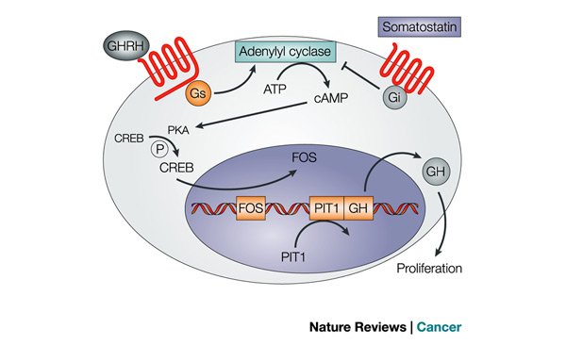
Anterior Pituitary
Hypothalamic | Anterior Pituitary | Cells
CRH | ACTH | Corticotropes
TRH | TSH/Prolactin | Thyrotropes/ Prolactins
GnRH | LH/FSH | Gonadotropes
GHRH | GH (increase) | Somatotropes
Somatostatin | GH (decrease) | Somatotropes
Asa SL, Ezzat S (2009) The pathogenesis of pituitary tumors. Annu Rev Pathol 4: 97–126. doi:10.1146/annurev.pathol.4.110807.092259.
Notes:
Mention all GPCRs

Slide 51
How Is Specificity Achieved in Hypothalic-Anterior Pituitary Signaling
Specialized target cells
Specific and direct neuronal connections
Different signaling cascades
All of the above

Slide 52
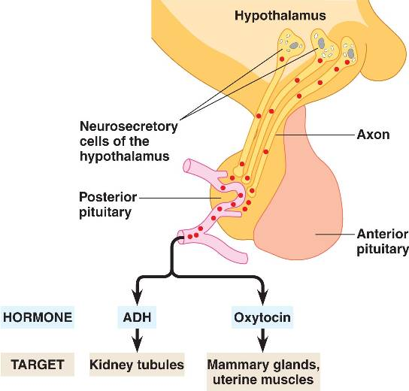
The Infundibulum and the Posterior Pituitary
Notes:
ADH is vasopressin

Slide 53
Vasopressin
Where is it made? | Posterior Pituitary
What causes its release? | Hypothalamic osmoreceptors (PVN/SFO) Mechanoreceptors (Carotid artery) | Increased osmotic pressure or reduced plasma volume
What are its receptors? | AVPR1-3 | GPCR (Gs)
What tissues does it affect? | Kidney (Collecting Ducts) | Water Reuptake (AQP2 trafficking)
 | Vascular System | Vasoconstriction
 | Anterior Pituitary | ACTH Release
How does it get turned off? | Normalization of volume/osmolality and AVPR receptor desensitization (arrestins)

Slide 54
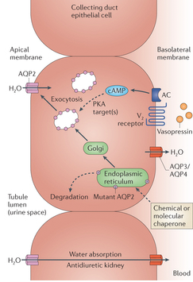
Effects of Vasopressin on the Kidney
Collecting
Tubules
Blood

Slide 55
Conditions with Altered Vasopressin Function
Lack of vasopressin signaling
Too much vasopressin signaling
Notes:
Not enough, can cause hypernatria, diabetes insipidus
This is because not enough water is pulled back in from the urine

Slide 56
Think About
How could whiplash cause diabetes insipidus?

Slide 57
Oxytocin
Where is it made? | Posterior Pituitary
What causes its release? | Synaptic activation in Hypothalamus (PVN, mechanism unclear)
What are its receptors? | OXTR
What tissues does it affect? | Uterus | Contractions
 | Mammary Glands | Let-Down Reflex (Lactation)
 | Neural | Positive Social Interactions
How does it get turned off? | Delivery (reduced input)

Slide 58
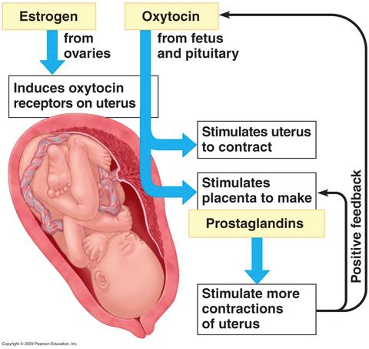
Oxytocin During Delivery

Slide 59
Your Future
Endocrine Control Systems
Neuroendocrinology and the Posterior Pituitary
Hypothalamus and Endocrine Control of Appetite
Endocrine Control of Growth
Adrenals and Stress Hormones
Pancreatic Hormones and Metabolic Control
Thyroid Hormones (KP)
Calcium Homeostasis (MF)
Reproductive Hormones (HP)

Slide 60
The End

